Slide 1


US Chicken Consumption
Report
CRM# US3003442
July 2018

Slide 2


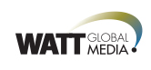


Primary research sponsor
Contributing
research sponsors
Research findings presented by

Slide 3
Project Background

Slide 4

WATT Global Media partnered with ORC International, on behalf of the National Chicken Council, to identify consumer trends related to the consumption of chicken that can be used by leading US poultry producers in their marketing efforts.
The primary objective of this research is to analyze chicken usage and attitudes among US consumers. Specifically:
  Gauge past two week consumption frequency (from supermarkets/grocery stores and food service establishments) and identify shifts in consumption behavior
  Determine reasons and frequency that chicken is chosen over other proteins
  Identify consumer concerns regarding purchasing chicken
  Determine knowledge of chicken care and desire and preferred sources for further information relative to chicken being purchased
A total of 1,004 interviews were conducted using ORC’s online CARAVAN® omnibus among a demographically representative US sample of adults 18+.
Completed interviews are weighted by five variables – age, sex, geographic region, race and education – to ensure reliable and accurate representation of the total US population.
Statistical testing throughout this report was conducted at the 95% confidence level.
June 4-7, 2018
BACKGROUND
OBJECTIVES
METHODOLOGY
FIELDING DATES

Slide 5
Insights & Implications

Slide 6
Executive Summary
Chicken consumption remains high and has recovered from the slight dip seen in 2017.
Consumers anticipate increasing their overall chicken consumption in the next 12 months.
Consumers continue to purchase chicken over other proteins because it is versatile and convenient.
However, fewer are purchasing chicken because it is healthy.
Nearly half are purchasing plant-based proteins as an alternative primarily because it is seen as a healthy.
Consumers are significantly more concerned this year about chicken purchase considerations than in any other year.
In addition, consumers find claims made on chicken packaging labels confusing and misleading and want to know more about them.
If provided with more information about the chicken they purchase, consumers would purchase more chicken.
The product package is the most desired source for this information.

Slide 7
Consumption Behavior

Slide 8
Chicken consumption remains high, bouncing back from the dip seen last year.
  SUPERMARKET
  Chicken Consumption Behavior
  FOOD SERVICE ESTABLISHMENT
  Chicken Consumption Behavior
Eaten Chicken Meal/Snack from Supermarket in Past 2 Weeks
Average Number of Times Eaten Chicken Meal/Snack from Supermarket in Past 2 Weeks
Eaten Chicken Meal/Snack from Food Service Establishment in Past 2 Weeks
Average Number of Times Eaten Chicken Meal/Snack from Food Service Establishment in Past 2 Weeks
Base: Total (1004)
Arrows indicate a significant increase/decrease from previous year at the 95% confidence level.

Slide 9
Consumers anticipate eating more chicken from both supermarkets and food service establishments in the next 12 months.
  SUPERMARKET
  Chicken Consumption Behavior
  FOOD SERVICE ESTABLISHMENT
  Chicken Consumption Behavior
86% of consumers have eaten a chicken meal or snack from a supermarket in the past two weeks
In the past two weeks, consumers have eaten a chicken meal or snack from a supermarket 3.7 times
29% of consumers anticipate eating MORE chicken from the supermarket in the next 12 months
68% of consumers have eaten a chicken meal or snack from a food service establishment in the past two weeks
In the past two weeks, consumers have eaten a chicken meal or snack from a food service establishment 2.2 times
19% of consumers anticipate eating MORE chicken from a food service establishment in the next 12 months
Base: Total (1004)
C1/2. Thinking about the meals and snacks you’ve eaten in the past two weeks, how many times did you eat chicken that was purchased from a supermarket or other retail grocery store/ restaurant, fast food store, carryout shop or employee cafeteria? This includes fresh, frozen, or prepared chicken/prepared meals of chicken, chicken products/sandwiches, and similar foodservice chicken items.
C3/4. During the next 12 months, would you say that you are likely to eat more chicken, less chicken, or about the same amount of chicken that was purchased from a supermarket or other retail grocery store/ restaurant, fast food store, carryout shop, or employee cafeteria?

Slide 10
The majority of consumers purchase chicken at least weekly.
Chicken Purchase Frequency
Base: Total (1004)
C5. How often do you purchase chicken to eat at home or order chicken when dining out?

Slide 11
Choosing Chicken versus Plant-Based Proteins

Slide 12
Consumers continue to choose chicken over other meat because it’s versatile and convenient. Fewer choose chicken because it’s healthy and low in fat than last year.
Reasons to Purchase Chicken Over Other Types of Meat
Base: Purchase Chicken (964)
2017
50%
53%
42%
35%
30%
37%
27%
C6. Why do you purchase or choose to eat chicken over other types of meat?
Arrows indicate a significant increase/decrease from previous year at the 95% confidence level.

Slide 13
Nearly half of consumers purchase plant-based proteins over chicken for a meal.
Non-Meat / Plant-Based Protein Purchase Frequency
Base: Purchase Chicken (964)
C7. How often do you choose a non-meat or plant-based protein (for example tofu, quinoa, veggie burger) over chicken for a meal?

Slide 14
Of those who choose a plant-based protein over chicken, nearly half do so because they believe it’s a healthy alternative. The majority are influenced by a dining partner’s meal choice to choose a non-meat meal at least sometimes.
Primary Reasons for Choosing Non-Meat / Plant-Based Protein Over Chicken
Base: Purchase Chicken and Choose Non-Meat / Plant-Based Protein over Chicken (458)
Frequency of Being Influenced by Dining Partner’s Choice of Vegetarian/Vegan Meal to Eat Non-Meat Meal
Base: Purchase Chicken and Choose Non-Meat / Plant-Based Protein over Chicken (458)
C8. What is the primary reason you choose the non-meat or plant-based protein over chicken?
C9. When dining with others, how often do you find that someone’s choice of vegetarian or vegan meal influences you to order
a non-meat meal?

Slide 15
Purchase Concerns, Knowledge Levels and
Desire for Information

Slide 16
Two-thirds of consumers consider themselves to be very or somewhat knowledgeable about the care of chickens. Those who are not at all knowledgeable declined from last year.
Knowledge Level on Care of Chickens
Base: Purchase Chicken (964)
 | 2018 | 2017
Very knowledgeable | 16% | 13%
Somewhat knowledgeable | 51% | 47%
Not at all knowledgeable | 33% | 40%
C10. How knowledgeable do you consider yourself to be on the care of chickens? In this survey, the care of chickens is defined as how chickens are raised, housed and fed.
Arrows indicate a significant increase/decrease from previous year at the 95% confidence level.

Slide 17
Consumers are more concerned about all of the purchase considerations listed than last year, which is the first time for these increases.
Chicken Purchase Concerns
Base: Purchase Chicken (964)
Extremely/Very Concerned
2018 | 2017 | 2016 | 2015
70% | 59% | 64% | 61%
74% | 69% | 71% | 71%
66% | 57% | 57% | 55%
62% | 55% | 55% | 50%
60% | 48% | 49% | 49%
53% | 43% | N/A | N/A
51% | 40% | 38% | 43%
49% | 41% | N/A | N/A
33% | 26% | 19% | N/A
C11. How concerned are you about each of the following when purchasing chicken?
Arrows indicate a significant increase/decrease from previous year at the 95% confidence level.

Slide 18
The majority of consumers who are concerned about the listed considerations would be more likely to purchase chicken if their concerns are addressed.
Purchase More Chicken if Specific Concerns Addressed
Base = Purchase Chicken and Rate Individual Consideration as “Extremely” or “Very” Concerned (varies)
C12. If your concerns about these areas were addressed, would you buy more chicken?

Slide 19
Consumers want more information about the chicken they buy and eat.
Items Consumers Want to Know More About
Base: Purchase Chicken (964)
Ranked 1st, 2nd or 3rd
39%
39%
38%
37%
34%
33%
29%
20%
89%
want additional information about chicken
11%
don’t need any additional information about chicken
C13. Which of the following would you like to learn more about for the chicken you buy and eat?

Slide 20
If provided with more information, the majority would buy more chicken. The preferred source is the product package.
Purchase More Chicken if Provided More Information
Base: Purchase Chicken and Want More Information (865)
Desired Sources to Learn More about Chicken
Base: Purchase Chicken and Want More Information (865)
FDA / USDA
Independent online searches
C14. If you were provided with more information, would you buy more chicken?
C15. Where would you be most likely to seek out more information?

Slide 21
Demographic Profile Across Key Segments

Slide 22

US Incidence Overview
GENERAL POPULATION
Age 18+
Base: Total (1004)
  TOTAL CHICKEN CONSUMERS
  92%
TOTAL NON CHICKEN CONSUMERS
8%
  SUPERMARKET
  (Number of Times Have Eaten Chicken
  from Supermarket in Past 2 Weeks)
  FOOD SERVICE ESTABLISHMENT
  (Number of Times Have Eaten Chicken
  from Restaurant, Fast Food Store,
  or Employee Cafeteria in Past 2 Weeks)
NON-USERS
(0 Times)
6%
LIGHT USERS
(1-3 Times)
53%
HEAVY USERS
(4+ Times)
42%
NON-USERS
(0 Times)
25%
LIGHT USERS
(1-2 Times)
47%
HEAVY USERS
(3+ Times)
29%

Slide 23
Consumers with the highest consumption levels tend to be younger, more ethnically diverse, live in larger households and have somewhat higher incomes.
TOTAL CHICKEN CONSUMERS
(920)
SUPERMARKET
HEAVY USERS
(382)
FOOD SERVICE ESTABLISHMENT
HEAVY USERS (263)
Gender
Age
(Mean: 46.9)
Household Size
(Mean 2.8)
  19% One
  34% Two
  17% Three
  17% Four
  13% Five Or More
Household Income
Mean: $65.8K
Ethnicity
16% Hispanic 13% African American
Gender
Age
(Mean: 44.8)
Household Size
(Mean 3.2)
  15% One
  31% Two
  18% Three
  20% Four
  16% Five Or More
Household Income
Mean: $66.7K
Ethnicity
16% Hispanic 13% African American
Gender
Age
(Mean: 42.5)
Household Size
(Mean 3.2)
  15% One
  28% Two
  20% Three
  19% Four
  19% Five Or More
Household Income
Mean: $73.2K
Ethnicity
23% Hispanic 12% African American
52%
48%
54%
46%
50%
50%
TOTAL CHICKEN CONSUMERS = Have Eaten Chicken From Supermarket Or Food Service Establishments In Past 2 Weeks
SUPERMARKET HEAVY USERS = Have Eaten Chicken From Supermarket 4+ Times In Past Two Weeks
FOOD SERVICE ESTABLISHMENT HEAVY USERS = Have Eaten Chicken From Food Service Establishments 3+ Times In Past Two Weeks

Slide 24
Demographics
ISO 20252 Certification
ORC International is ISO 20252 certified. To achieve certification, ORC International passed a comprehensive, on-site audit. The certification establishes globally recognized terms, definitions, and service requirements for project management in research organizations. Processes outlined in ISO 20252 are designed to produce transparent, consistent, well documented and error-free methods of conducting and managing research projects. Adherence and certification to such standards provides a basis of confidence for clients and other constituencies that the work produced is being executed with quality processes and controls in place. The internationally recognized standard also provides a basis for subcontractor evaluation.

Slide 25
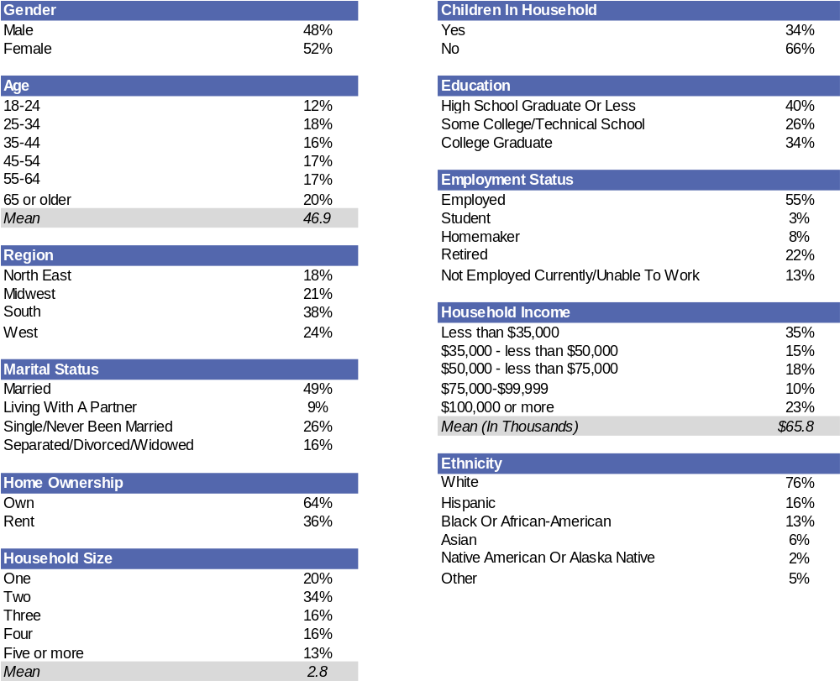
Demographics
Base: Total (1004)

Slide 26
Appendix

Slide 27
Consumers are more concerned about nearly all of the purchase considerations listed than last year.
Top 3 Box
Scores
Chicken Purchase Concerns
Base: Purchase Chicken (964)
Extremely/Very/Somewhat Concerned
2018 | 2017 | 2016 | 2015
88% | 80% | 88% | 82%
92% | 91% | 93% | 90%
87% | 83% | 87% | 79%
87% | 83% | 85% | 79%
85% | 78% | 87% | 77%
78% | 74% | N/A | N/A
78% | 72% | 77% | 70%
77% | 71% | N/A | N/A
61% | 55% | 53% | N/A
C11. How concerned are you about each of the following when purchasing chicken?

