Slide 1
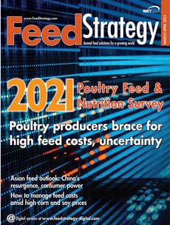
2021 Poultry Nutrition & Feeding Survey
WATT Global Media’s annual Poultry Nutrition & Feeding Survey offers a firsthand look at the macro trends impacting the poultry industry worldwide.
The 2021 survey includes input from 560 respondents from around the world. More than half are nutritionists, consultants and veterinarians; 16% work in live production management or own a poultry farm.
Click the image on the left to see the full report.
We hope you will use these presentation-ready images in your own documents. We ask that you please always display the WATT Global Media copyright and the source citation.

Slide 2
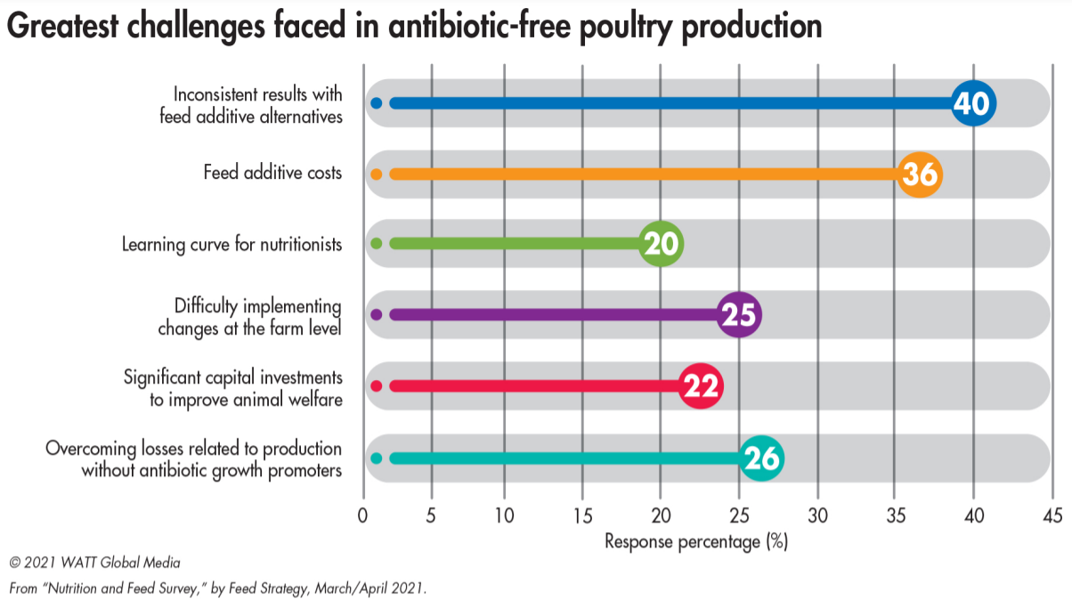

Slide 3
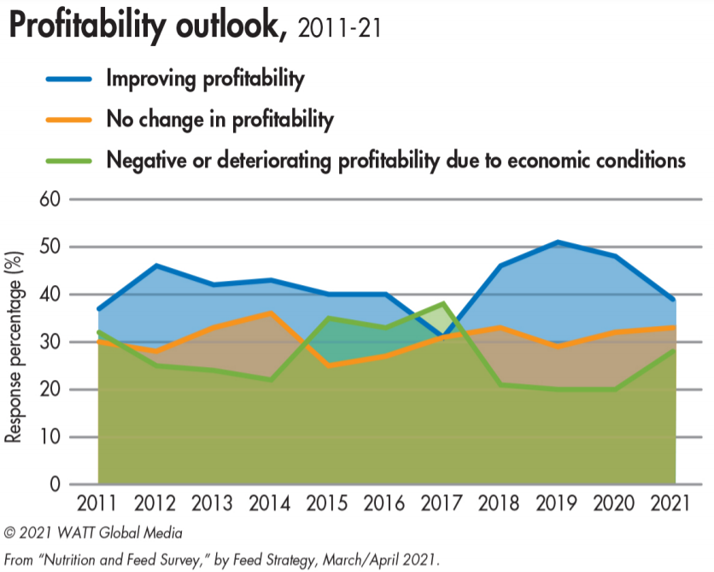

Slide 4
